Slide 1
E-Commerce Store
Fusion of web-tech & marketing
Saqlain Mahin
Supervisor: Harry Goldberg

Slide 2
E-Commerce Store
Background
providing a core objective to promote E-Commerce as it is the merger of technological advancements related to IT and Marketing.
to start with small-scale retails to attain large-scale business.
To quickly boost business profits.
To throw an insight to how E-Commerce or E-Business develop and works.
To elaborate how technology like PHP, XAMPP and myphpadmin is useful to develop such websites.

Slide 3
Overview and Functionalities
Developed in PHP so only XAMPP is needed to install it and it also contains the Apache Server and MySQL for the database.
Tools needed: XAMPP Server and MySQL for the database. notepad++, VScode for coding.
Methodology used is RAD-Rapid Application Development, a step by step methodology to meet the final stage.
Business Modeling
Data Modeling
Process Modeling
Application Generation

Slide 4
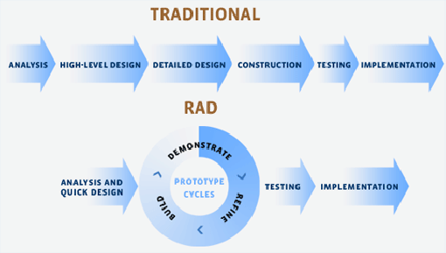
RAD-Rapid Application Development Model

Slide 5
Functionalities
Online Shopping Platform
Admin Management and Centralized Security
User Registration
Reviews and Ratings
Home Delivery Option
Order Management
Order Tracking
Online Payment

Slide 6
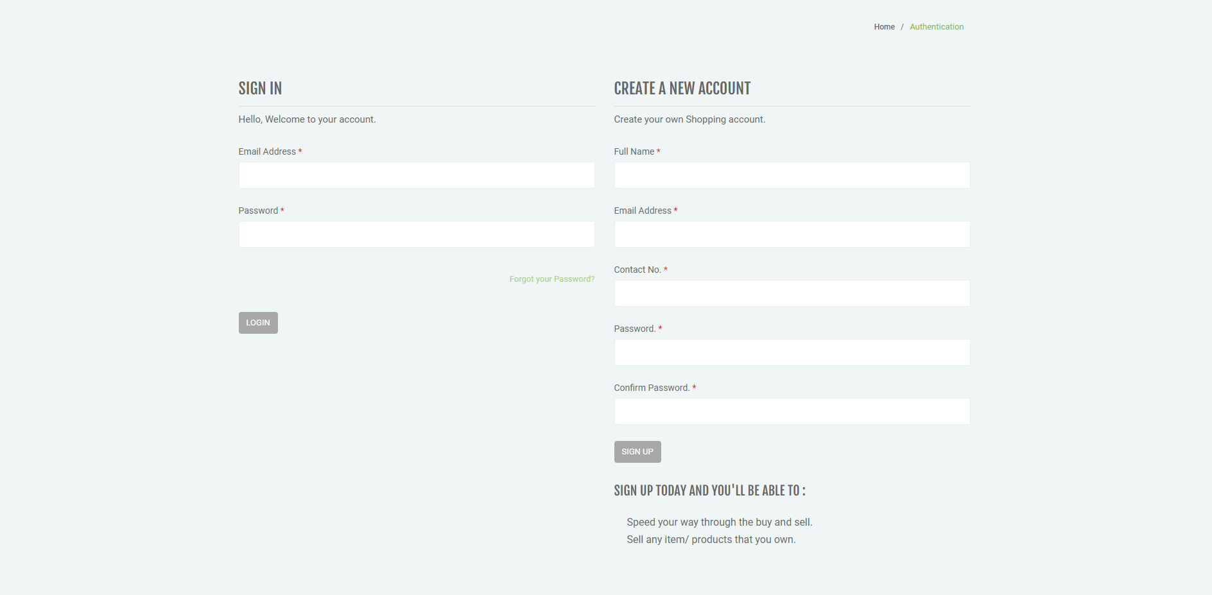
Main Features
User Registration:

Slide 7
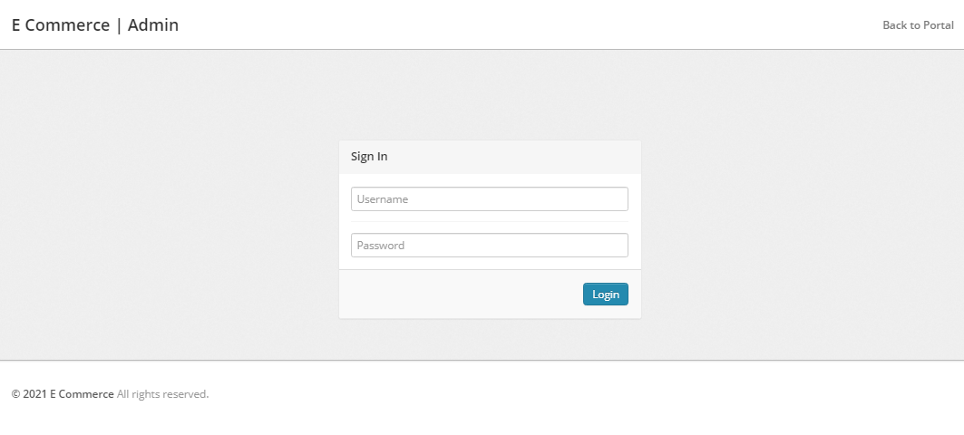
Main Features
Admin Panel:

Slide 8
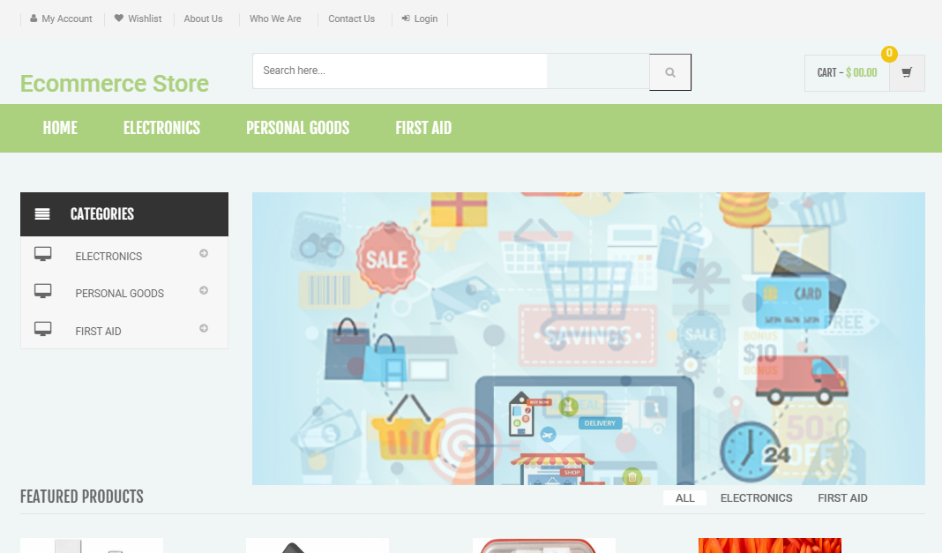
Main Features
Products Section

Slide 9
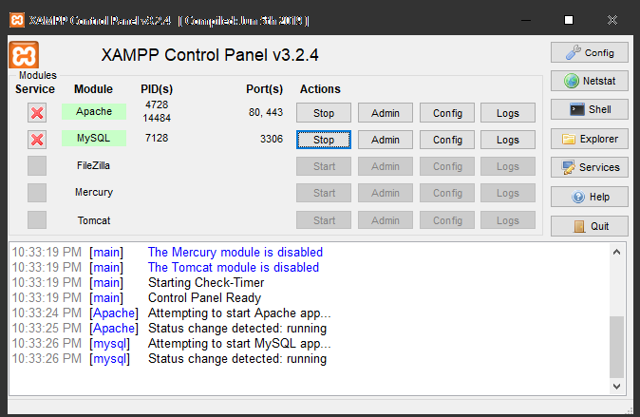
Demonstration
Screen-Sharing to show the working of the project will be given via online session
All three basic tools will be shown
XAMPP

Slide 10
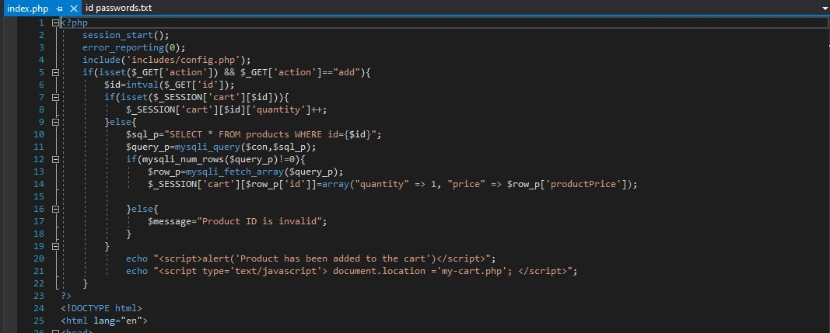
Demonstration
Code

Slide 11
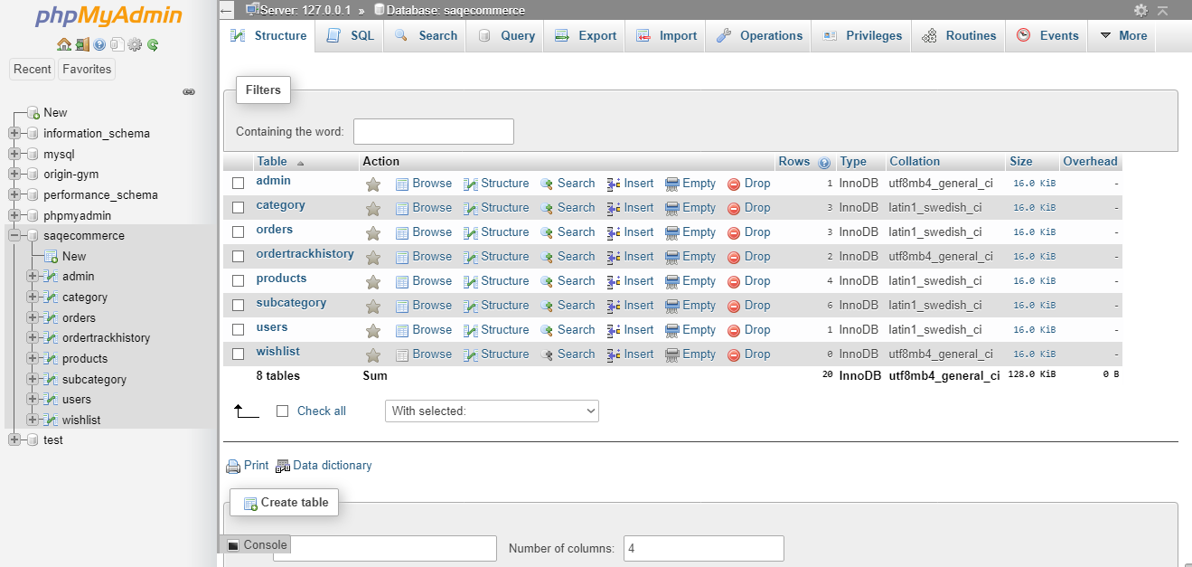
Demonstration
myphpadmin (localhost)

Slide 12






Demo
http://localhost/ecommerce-saqlain/index.php

Slide 13
Challenges
Constructional Challenges: refining, modification and enhancement the prototype, independent work, project management
Testing Strategy: Security of Users and Users Information
Starting with Cookies-Based Project to a Proper Website of E-Commerce Enhancement.
Schedule/ Time Management
Connecting XAMPP, myphpadmin with Coding tool
Interface Designing with CSS and HTML.

Slide 14
Reflection
Future Goals
Looking forward to develop it by adding more products/team members for future development.
Better web-design to be implemented to attract users
Better Management with more Security and Reliability
Develop easy ways to implement more functions in coding
Well-defined categories and sub-categories
Transparency Viewing and Reviews of the products

Slide 15
Reflection
Learnings and Implementations
Learning an Insight to the growing E-Commerce website development
Better understanding of the theoretical learnings by implementing it in coding
Coding for Web-Designs in HTML, CSS
Using SQL Queries by creating database on myphpadmin
Project Management
Developing on new platform and implementing all learning outcomes.

